Slide 1

Using power point for a good method of presenting work.
By Jordan Etheridge.

Slide 2
Good points..
1. Easy to use.
2. Usually free with your pc (so no paying for it.)
3. Great features.
4. Easily put anything you want into a presentation.
5. Great use of slide presentation (which will be shown as we go along.)

Slide 3
1. Easy to use..
Power point is so easy to use they practically have everything you need to make a good presentation right in front of your eyes!
Basically everything is on the first page as you get onto power point.
You can incorporate slide transitions, different backgrounds and different fonts easily with one click!

Slide 4
2. Free to use..
Free download usually, unless you don’t have the software already, but is generally on every new computer or laptop!

Slide 5
Features at your fingertips.
In this next slide I will put some pictures of the simple features you can use when making and presenting a power point presentation.

Slide 6

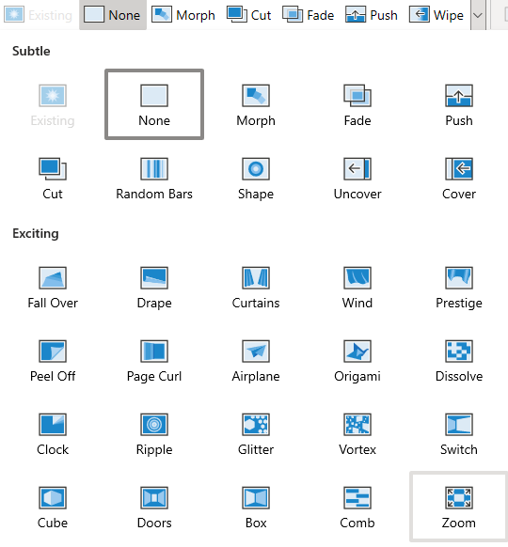

Background designer
Transition effects
This is for drawing on your power point if you need something circled or marked
this is your insert tab.
Basically as it is shown you can insert any of these.

Slide 7
Easily put anything into your presentation with ease
So as shown above you can just use the tools shown to easily put anything into you presentation with a couple simple clicks its really easy and quite fun to use!

Slide 8
Why I like power point and why you should too..
Ok so as showed above you can do so much with power point I just think power point is a great thing to use and it's so easy and productive. You can do so much with it or even just keep it simple and still get a great presentation of power point! Feel free to leave comment on how this presentation is as I am open to constructive criticism and I hope you all enjoyed!

Slide 9
Made by Jordan Etheridge.

